Slide 1
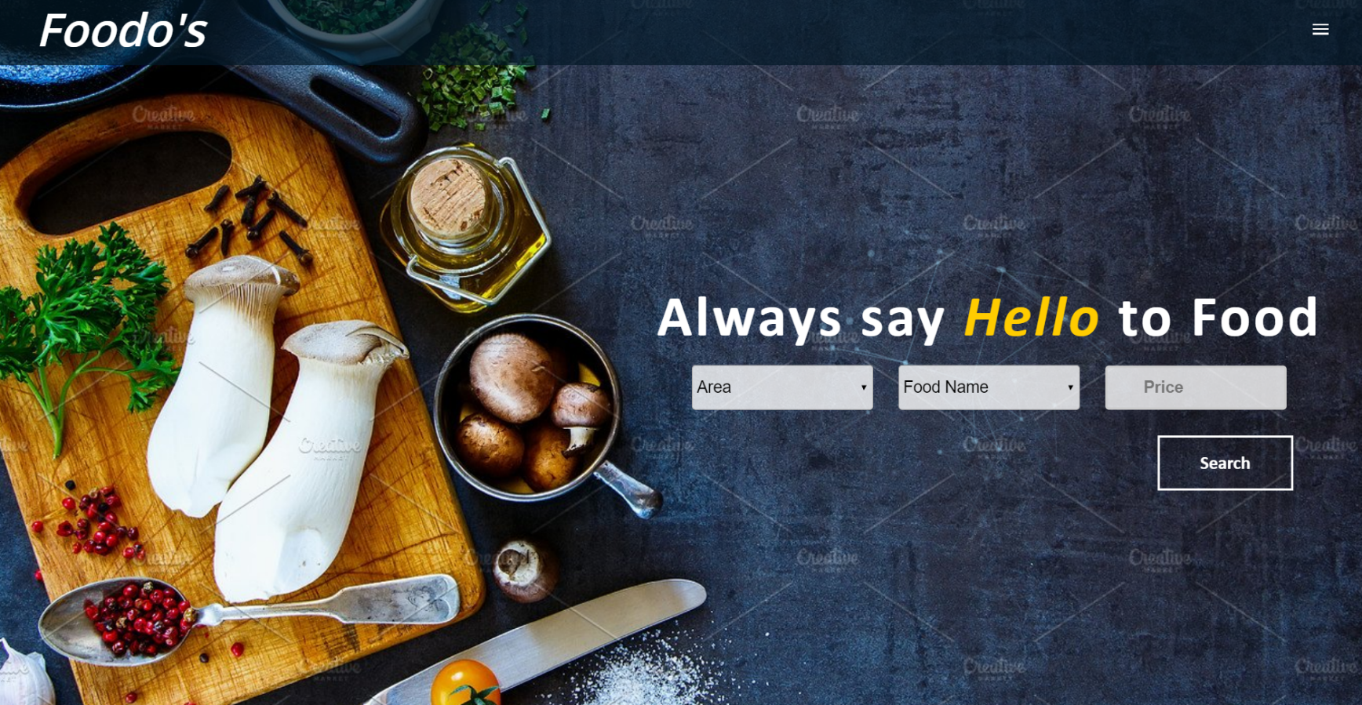
Foodo’s

Slide 2
Members
S. M. Tawhidur Rahman
Tauhida Shabrin Shimmy
S. M. Raihan Gafur

Slide 3
Overview
How the
Software will
work
Question
Solution
Problem Statement
How blockchain
Will work
Conclusion

Slide 4
Problem Statement
Filtered food place search
Searched food place location
Direct order to the desired food place

Slide 5
Solution
Filter option would help to find the desired restaurant within the given place, price and food item
Desired food place location can be found from the map fast
A direct online order can be given to the desired place instantly

Slide 6
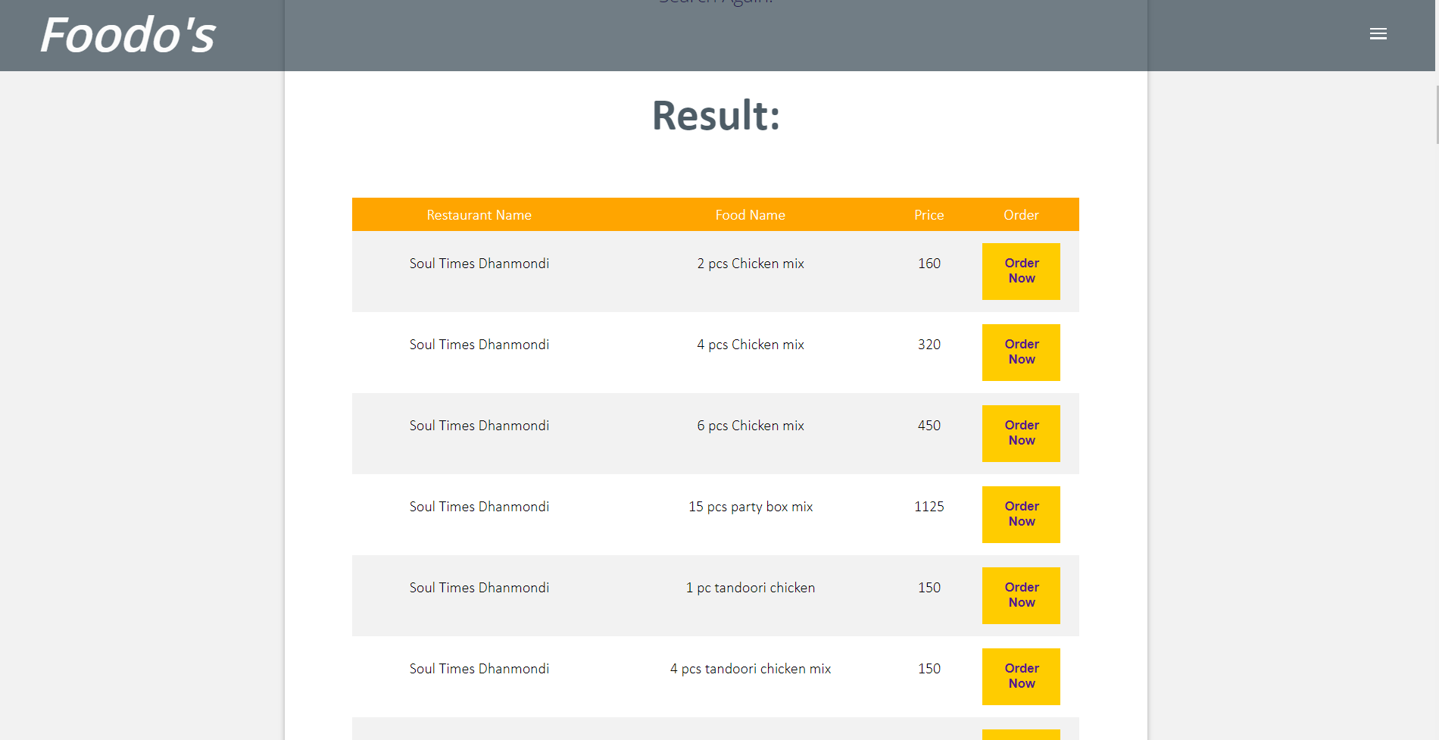
Conclusion
nsdkjfhbsdjk

Slide 7

Any Question?

